Slide 1
When Love Hurts
Putting knowledge of brain injury from intimate partner violence into practice
Karen Mason
SOAR Co-founder and executive director
Paul van Donkelaar
SOAR Co-founder/principal investigator and professor
University of British Columbia (Okanagan)

Slide 2
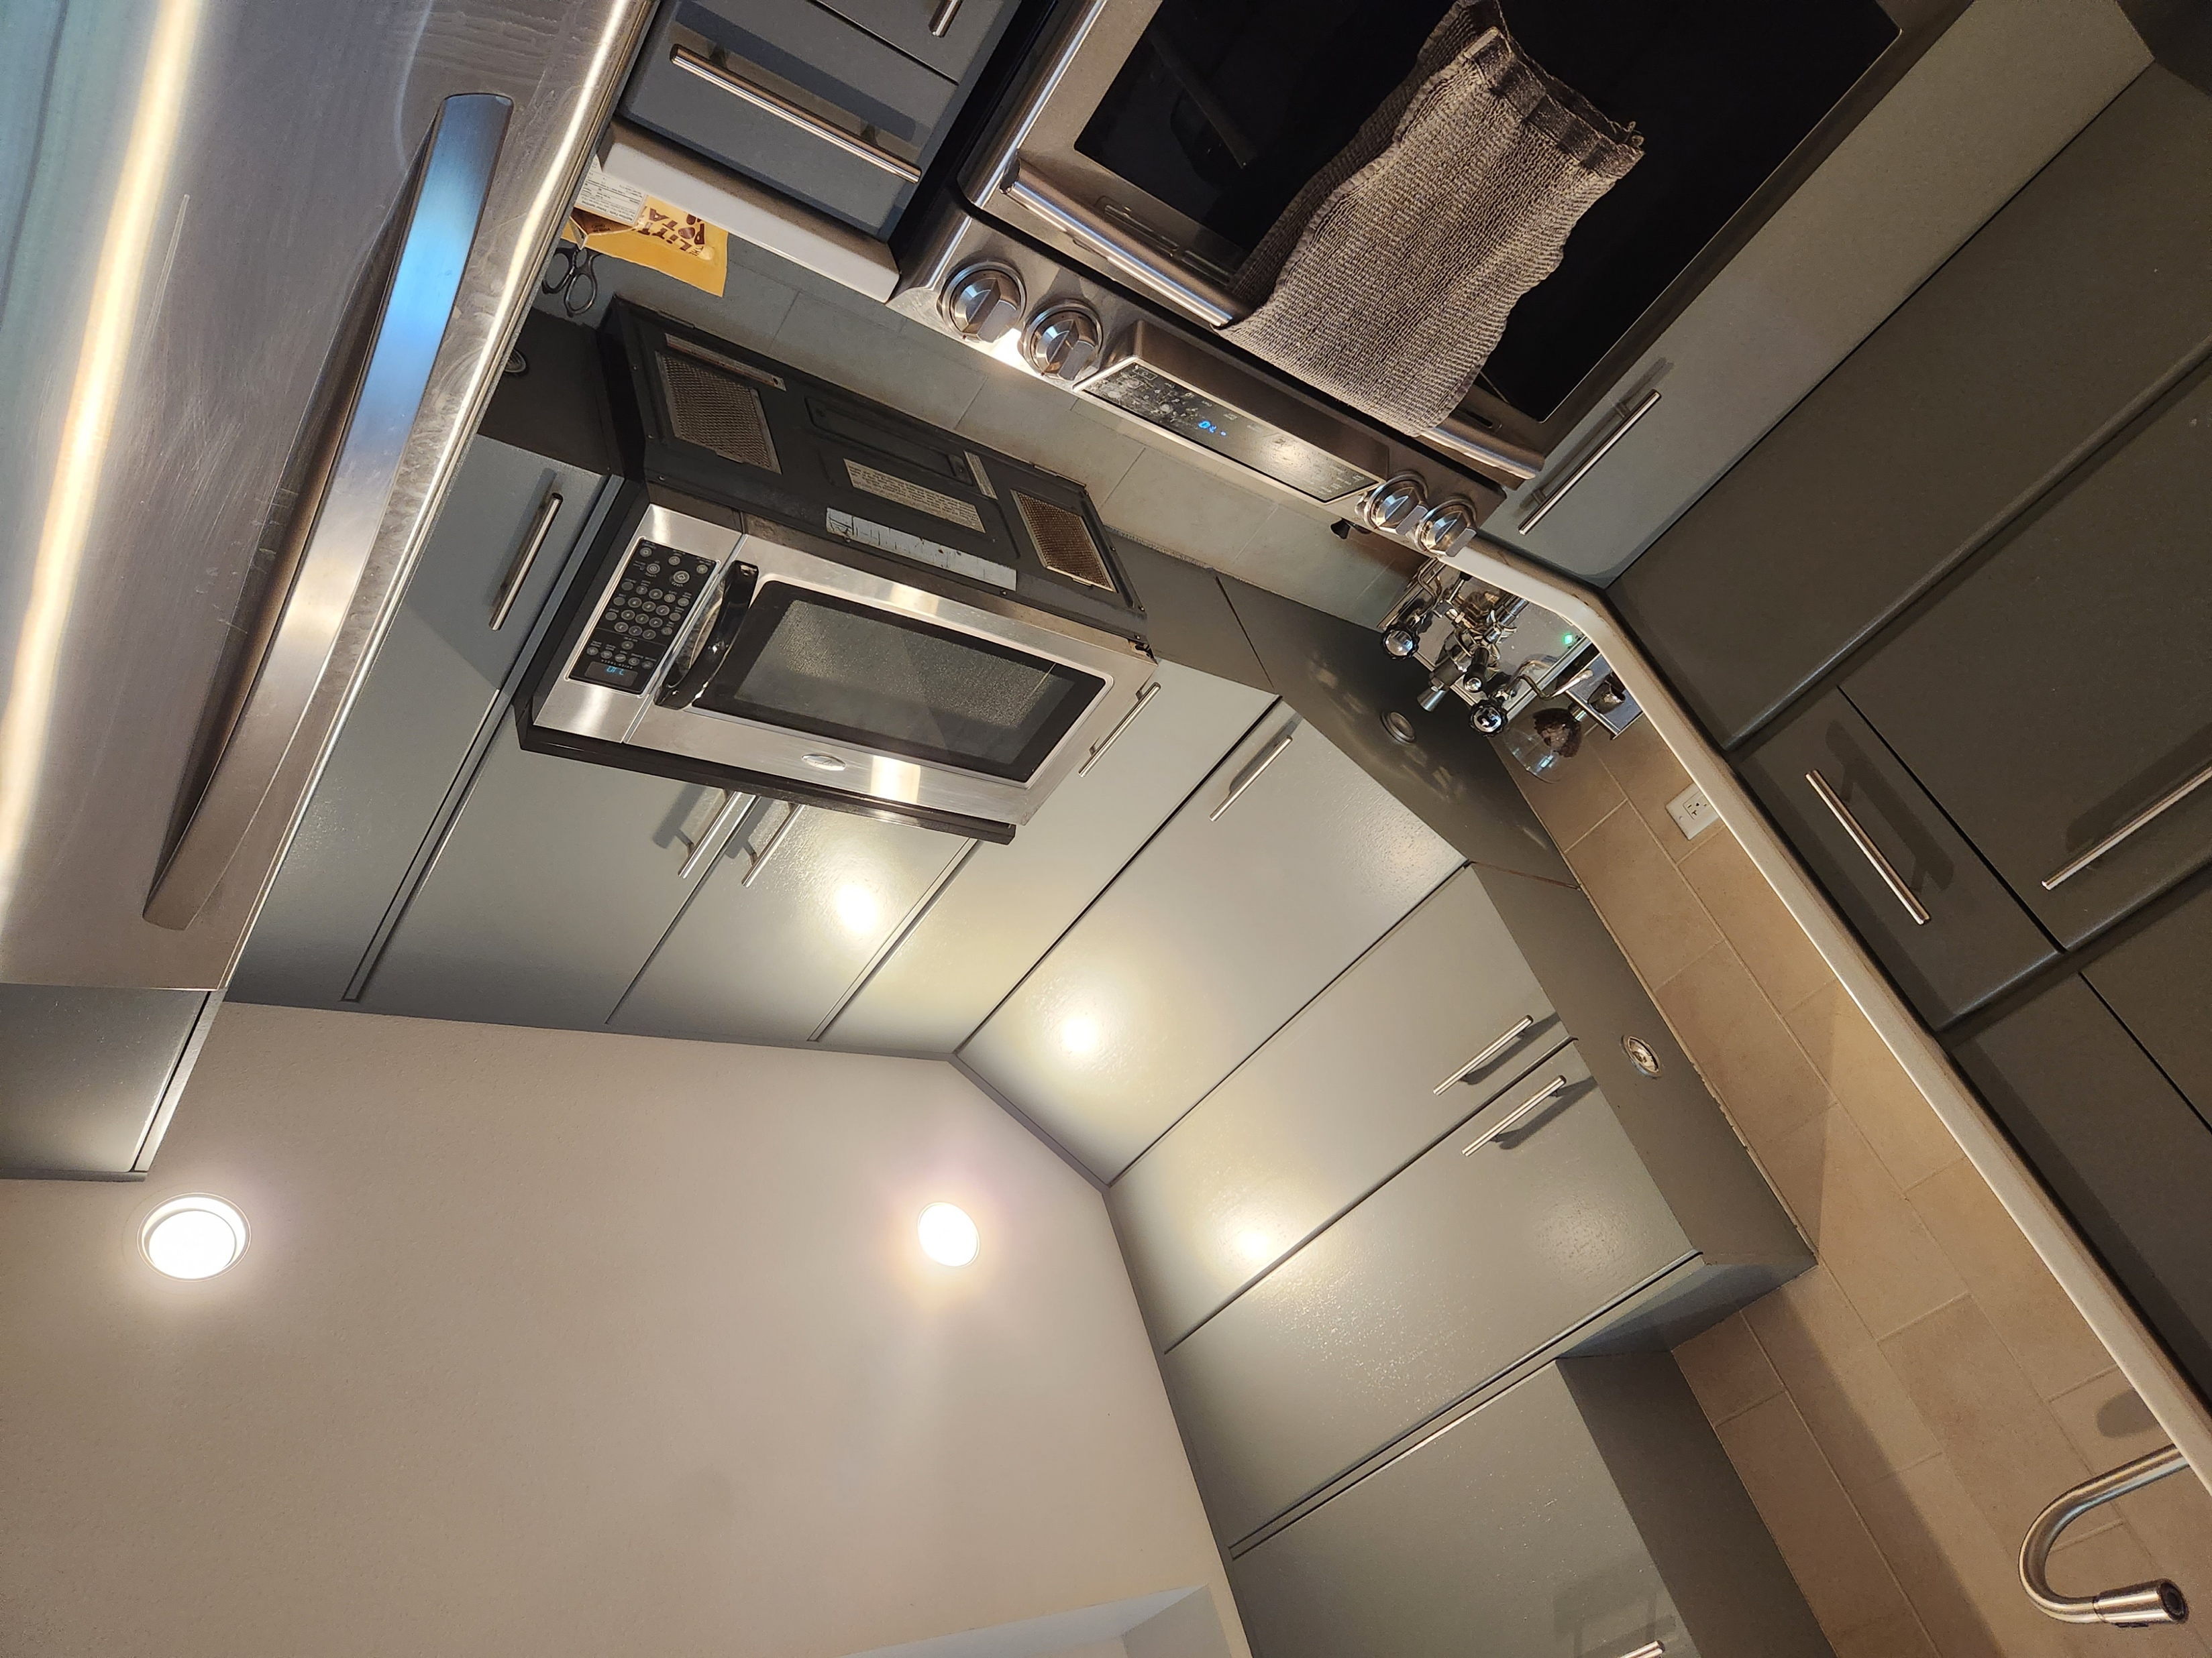

Slide 3
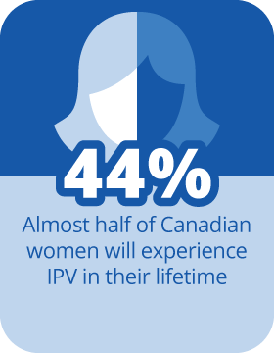
Did you know?

Slide 4
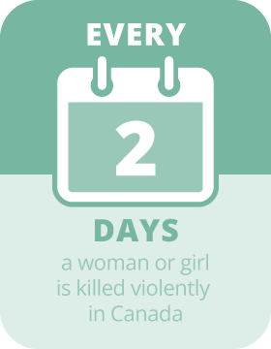
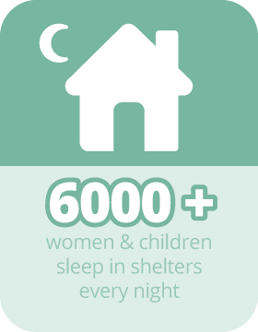
Did you know?

Slide 5
Types of abuse
Physical
Emotional, psychological, and verbal
Financial
Isolation and social
Sexualized
Cultural and Spiritual
Abuse is an incident or pattern
of incidents of controlling,
coercive, threatening,
degrading, and violent behavior.

Slide 6
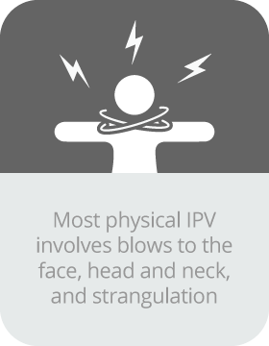
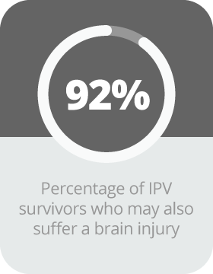
Did you know?

Slide 7
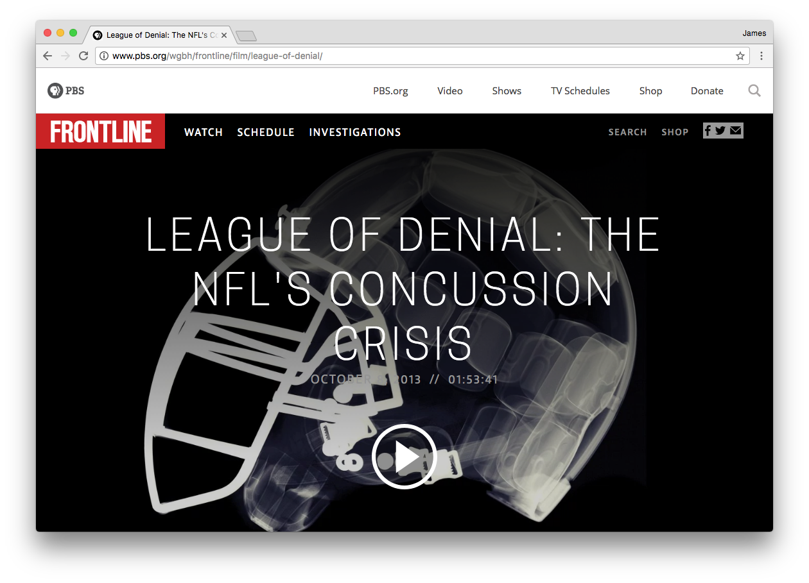

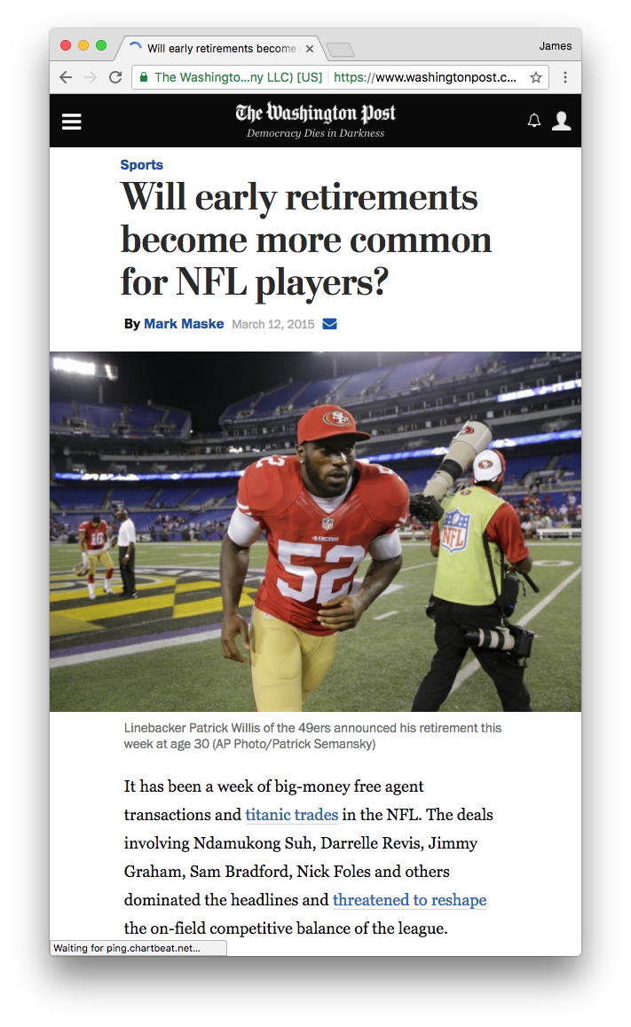


Slide 8




The backstory

Slide 9
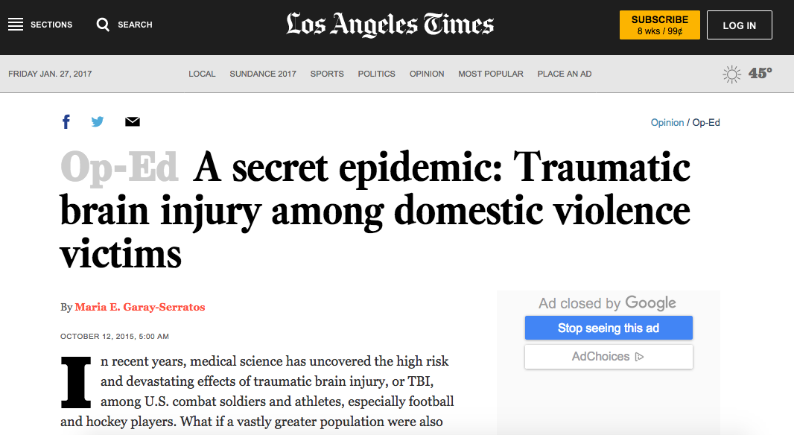

Slide 10

SOAR
What is it?
Community-engaged, multi-disciplinary research initiative
Launched in 2016 between UBCO and Kelowna Women’s Shelter
Now a non-profit initiative
What are the goals?
EXPLORE - Characterize the incidence and effects of BI in IPV.
EDUCATE - Educate and train those who work with survivors.
EMPOWER - Create better awareness and support services.

Slide 11

Explore
Characterize incidence and effects of TBI in IPV
Acute phase (within 1 week of incident)
Retrospective chart review of Embrace Clinic patients
Analysis of evidence consistent with brain injury from chart narrative and details
Chronic phase (months to years after 1 or more incidents)
Recruitment of clients from KWS and other community organizations.
Direct assessment of PTSD, anxiety, depression, trauma history, substance use, self-reported history of brain injury resulting from IPV, symptoms, and neurocognitive function

Slide 12
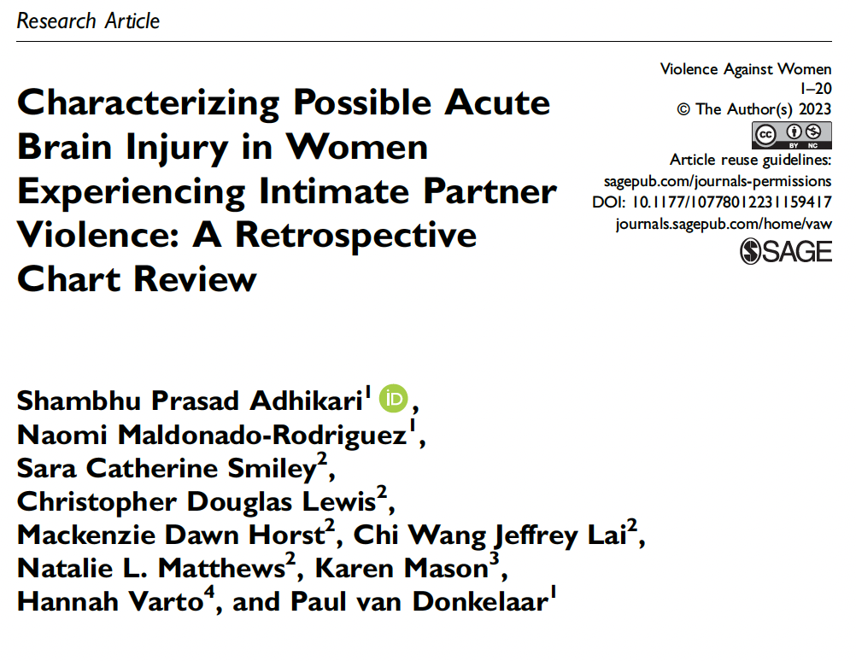
Explore - Acute Phase

Slide 13
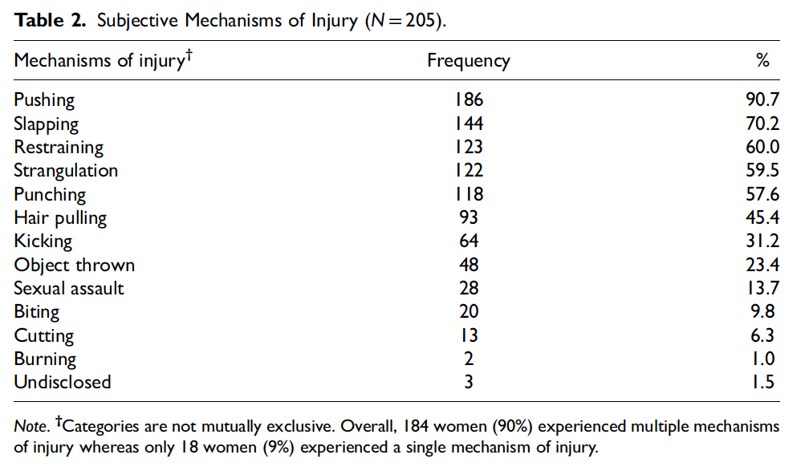
Explore - Acute Phase

Slide 14
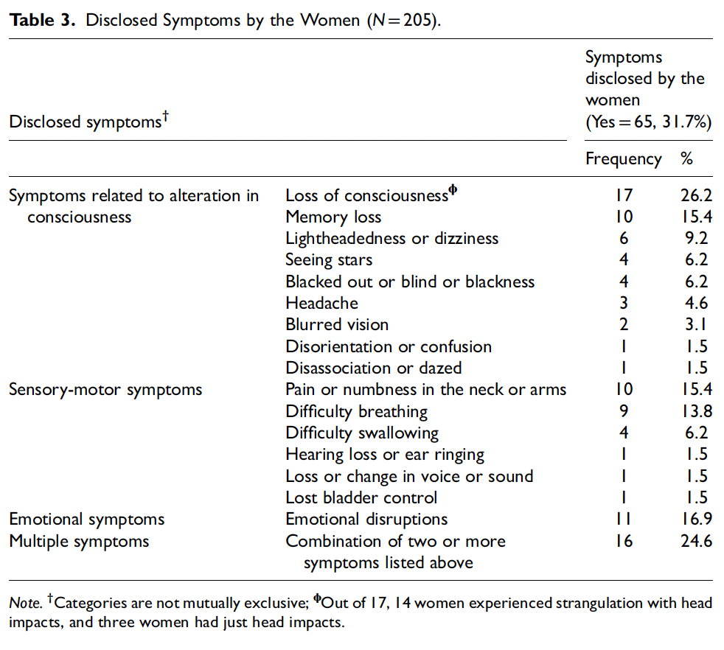
Explore - Acute Phase

Slide 15

Explore - Acute Phase
What we found
Clear direct evidence that strangulation is occurring frequently in Embrace Clinic patients
Women experiencing strangulation 2.24 times more likely to report brain injury symptoms
Brain injury symptoms were disclosed in 31% of cases despite not being directly asked about it

Slide 16
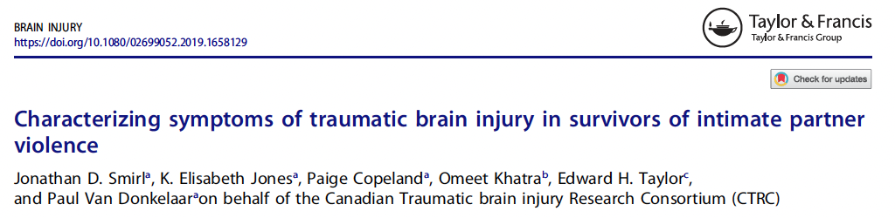
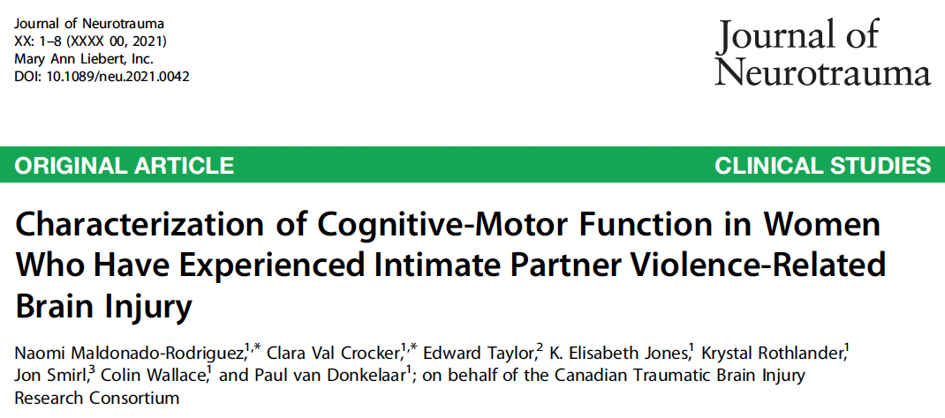
Explore - Chronic Phase

Slide 17
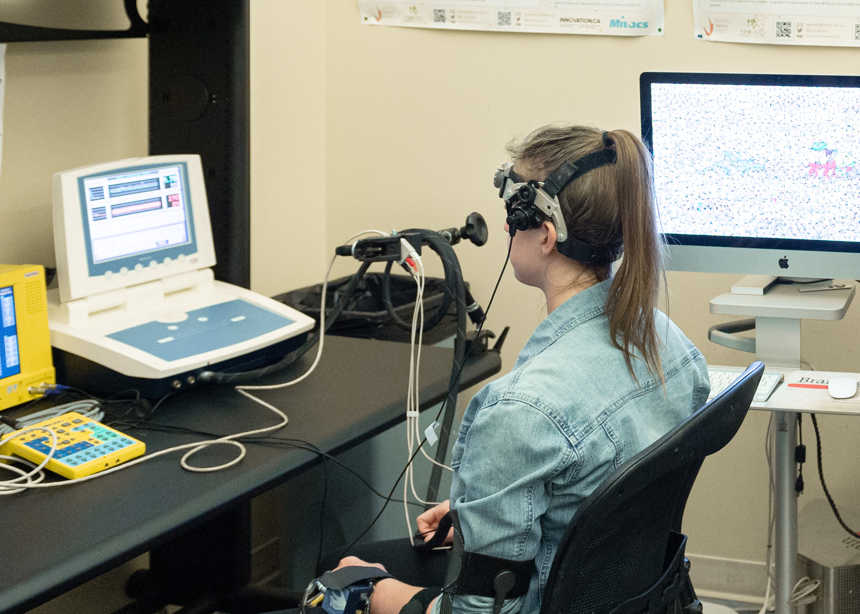
Explore – Chronic Phase
Characterize incidence and effects of BI in IPV
Lab-based assessments
Brain blood flow measurement
Blood draws
Assessments of neurocognitive function

Slide 18
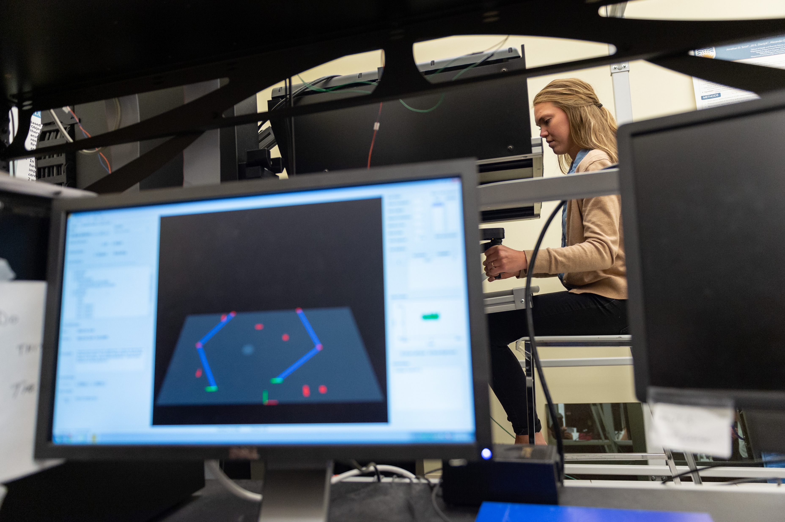
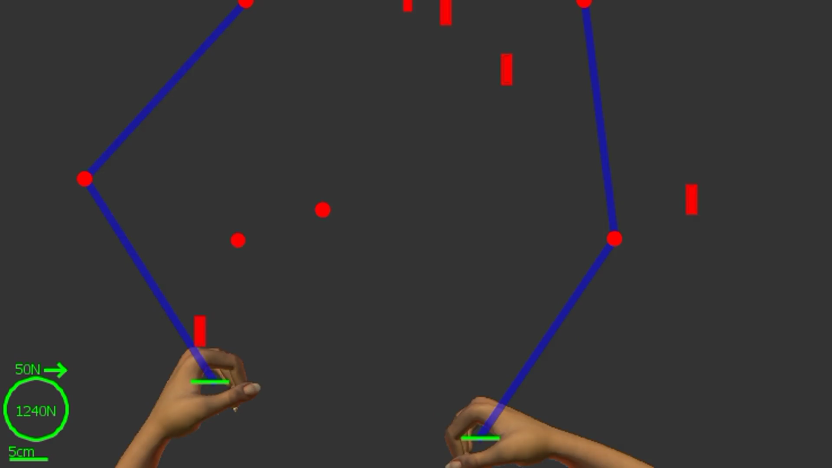
Explore - Chronic Phase
KINARM: cognitive/sensorimotor function

Slide 19
Explore - Chronic Phase
Conclusions
Majority of participants – 92% - experienced IPV-related BI.
Those who were strangled had higher BISA scores.
Indigenous women were over-represented (20% compared to 7% of population)
Number of symptoms greater than that observed in acute sport-related concussion.
Reduced ability to make fast coordinated movements.
Repeated TBIs; chronic symptoms; long-term consequences.

Slide 20
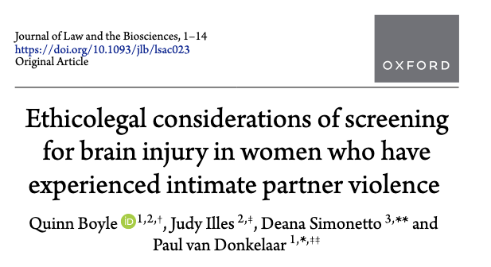
Explore – Implications of BI Screening

Slide 21
Explore – Implications of BI Screening
The problem
Stigmatized health info has history of legal implications in family law.
Questioning capacity to parent based on health status in parenting and access disputes
Mental health and substance use
Courtroom distress exacerbates symptoms
The question
Is it appropriate to screen women survivors of IPV for BI in the context of family law?

Slide 22
Explore – Implications of BI Screening
IPV BI leaves women legally vulnerable due to:
Lack of legal precedent and understanding in legal profession.
Difficulty establishing scientific and legal links between BI and IPV.
BI is not the problem:
The system and its ideologies of sexism and racism are the issue.
Screening:
Requires careful ethico-legal consideration to equip women to successfully navigate the system.

Slide 23
Recommendations
Explore – Implications of BI Screening
Expert allyship
Physicians and others
Trauma-informed legal team
Education on IPV-BI for lawyers and judges
Assessment of parenting capacity
Anticipate skepticism and incorporate assessment within IPV-BI screening tool
Transparency and the right to opt-out
Knowledge is power, and women must be offered information and agency.

Slide 24
Educate
Surveyed 150 women’s shelter workers
Gauge knowledge on BI in IPV.
Determine screening practices.
Explore barriers to screening.
Get feedback on top screening tools.
Develop recommendations.

Slide 25
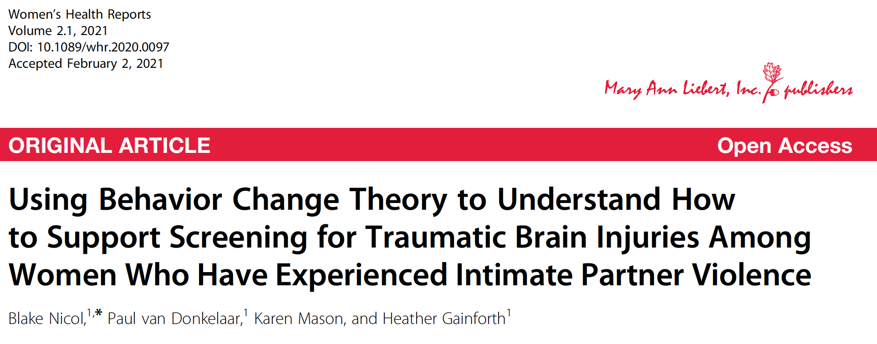
Educate

Slide 26
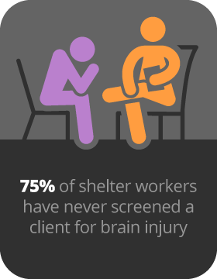
Educate
Barriers to screening
Lack of knowledge, skills, ability, and organizational support
Limits on time and resources
Fear of client reaction
Recommendations
Formal organizational policies/procedures
Training and education for staff and clients
Informal, conversational-style screening
Referral system

Slide 27
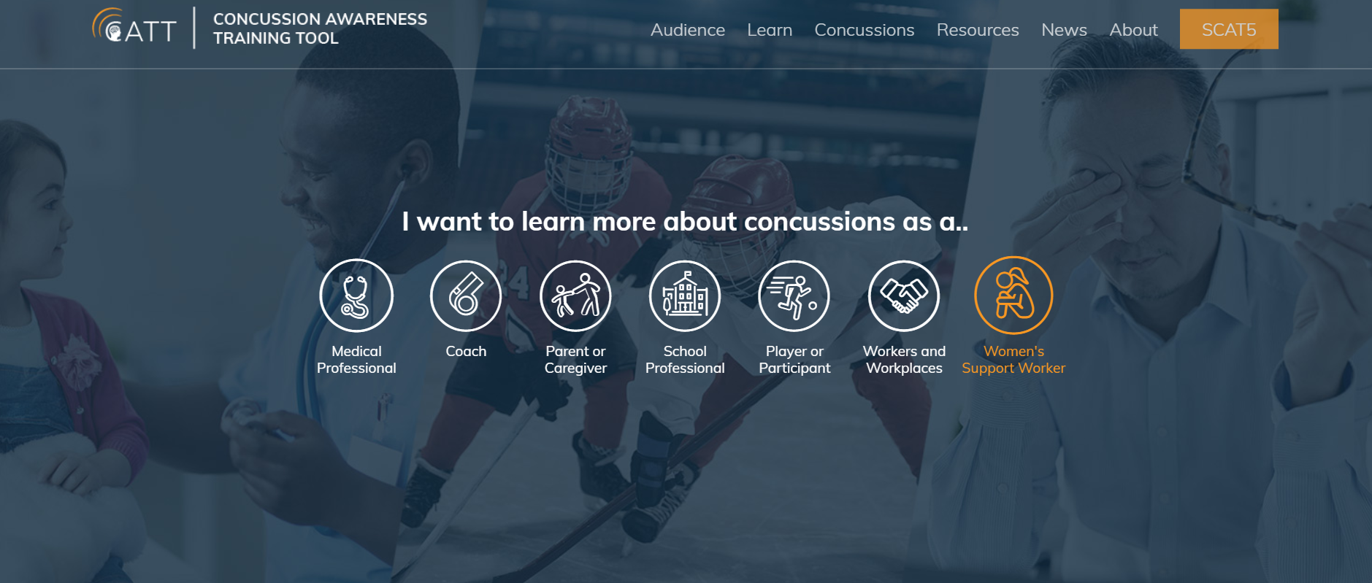
Educate

Slide 28
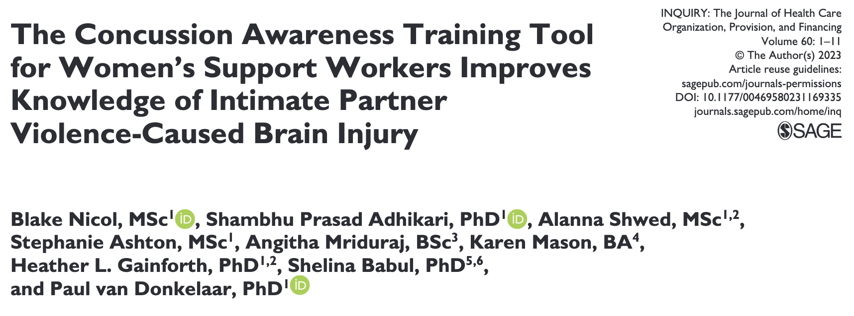
Educate

Slide 29
Educate
110+ participants
Average increase of 1.6 points out of 12 overall – 13%
18% increase in those who recognized red flags
63% increase in those who knew commonality of BI symptoms
21% increase in those who recognized support strategies
Changes reported in how they support clients

Slide 30
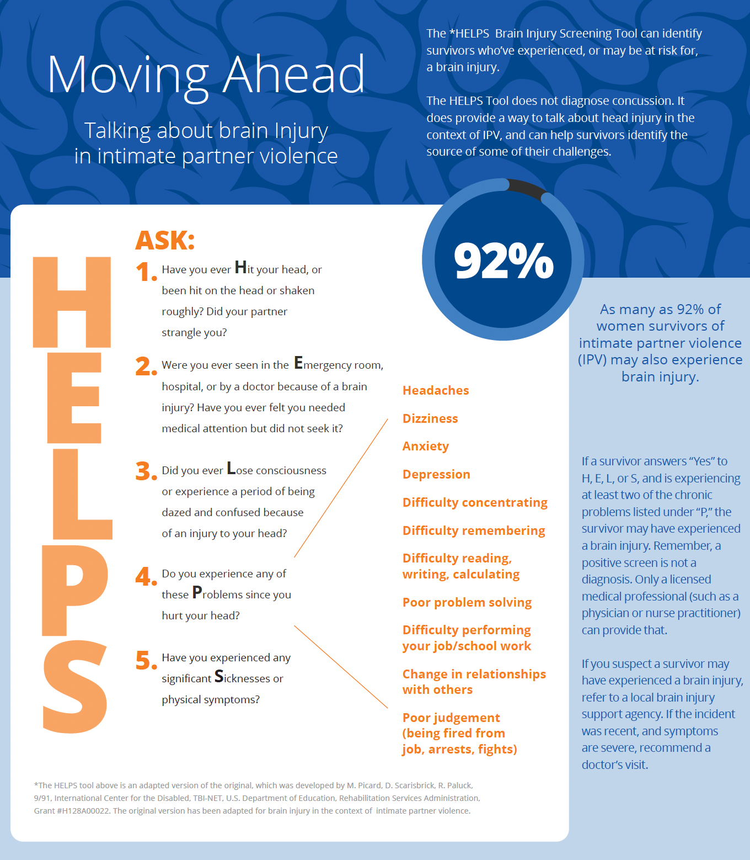
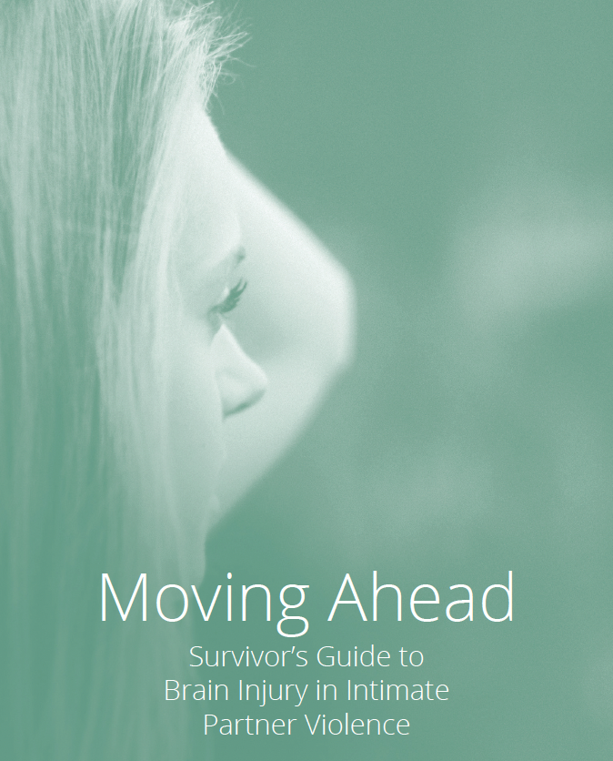
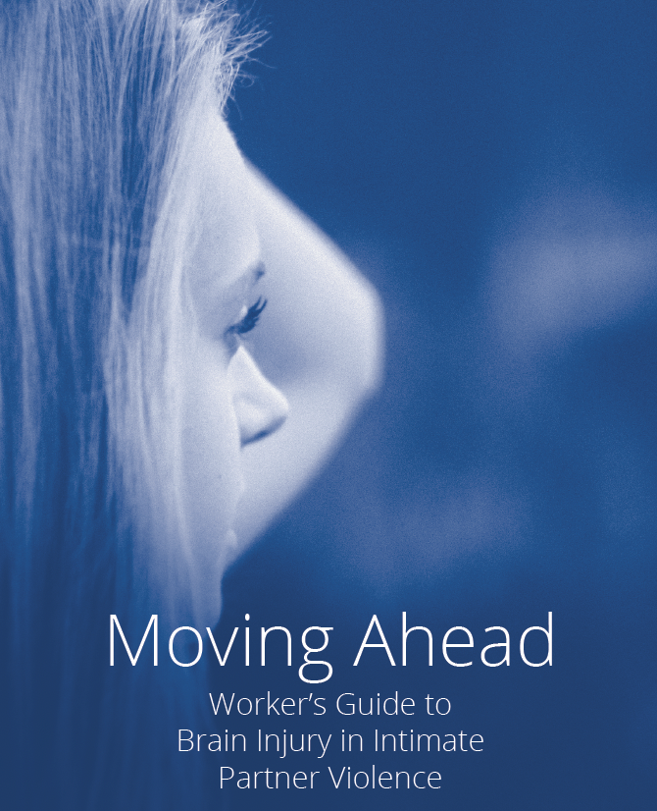
Educate

Slide 31
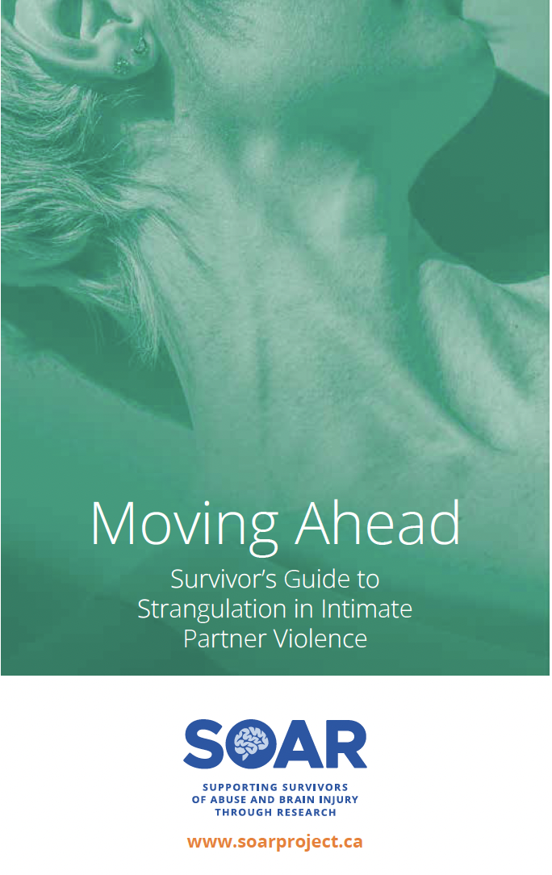
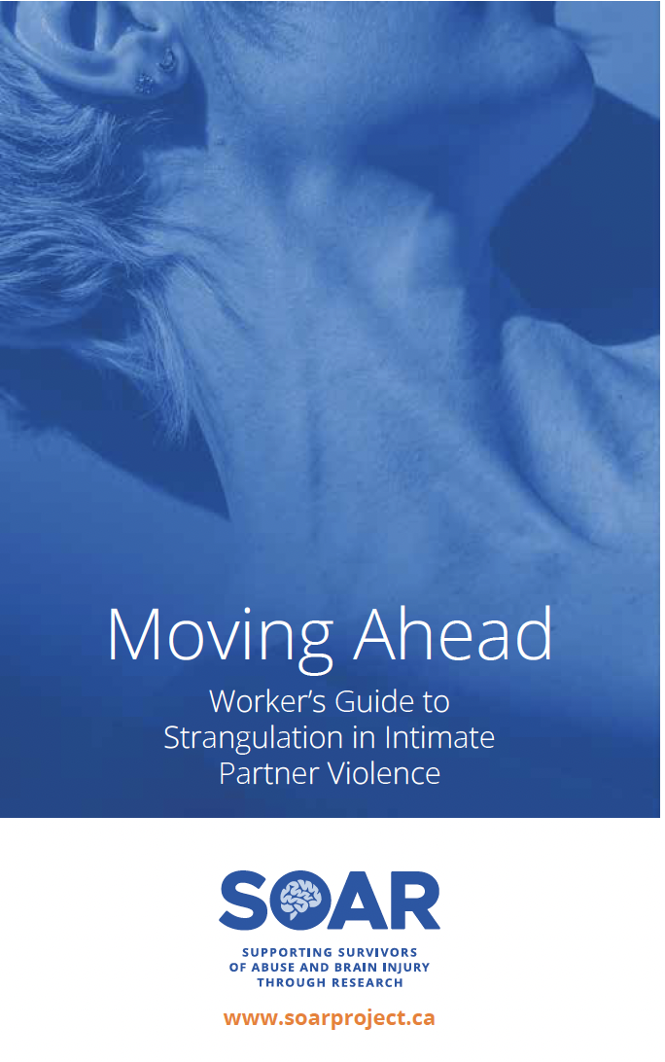
Educate
Strangulation

Slide 32
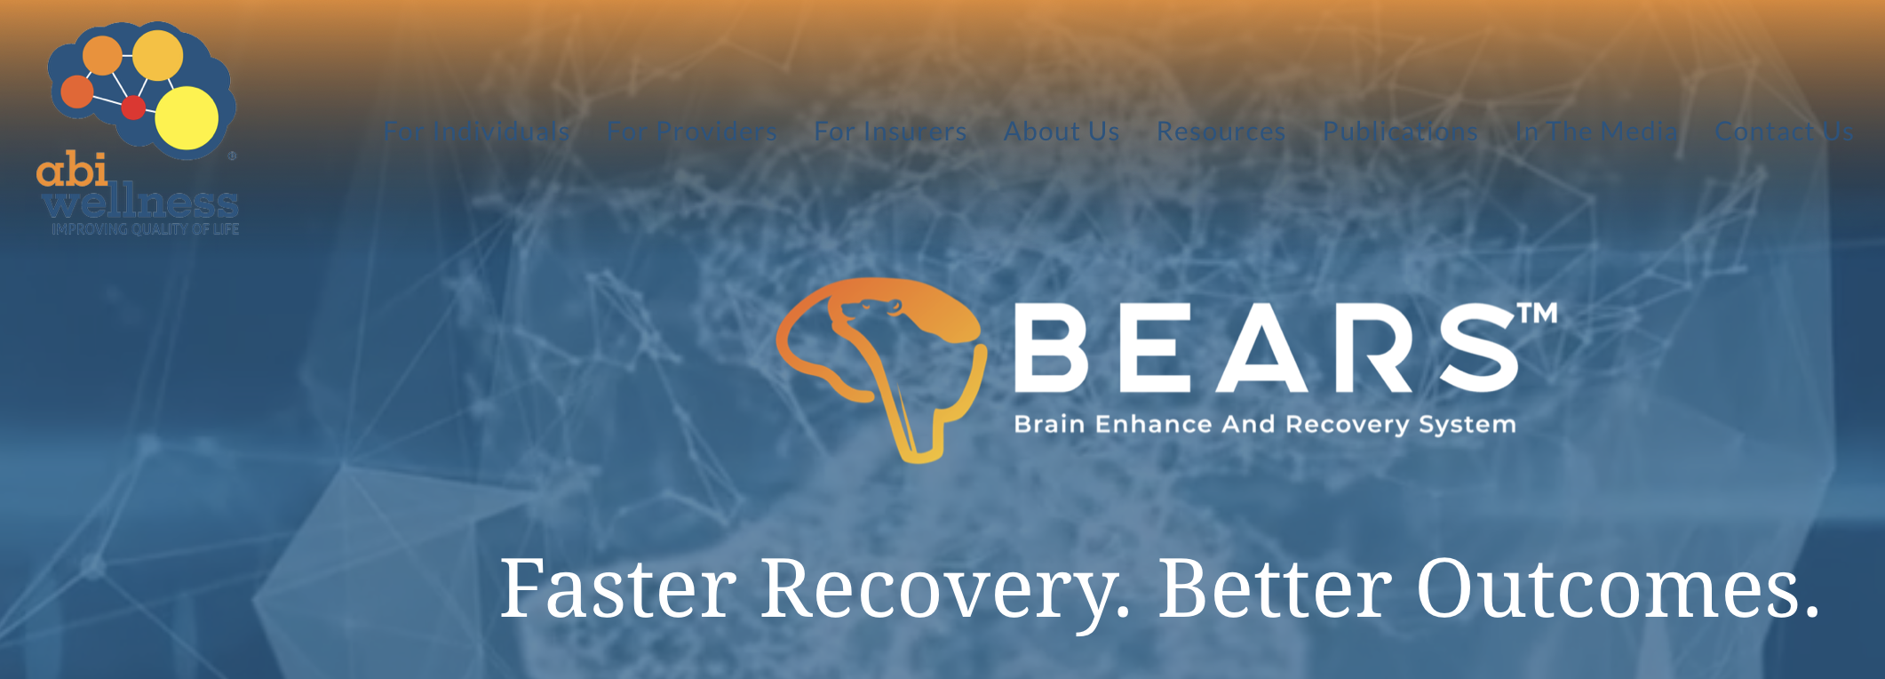
Empower – Evaluating interventions
Community Support Network (CSN)
Part-time, long-term rehabilitation intervention program based on Brain Enhance and Recovery System (BEARS) program.
Multifaceted (aerobic exercise, mindfulness/meditation, and cognitive exercises).

Slide 33
Empower – Evaluating interventions
Community Support Network (CSN)
Includes clinical counselling and support from a participant navigator with lived experience of BI.
Survey participants to measure changes in quality of life, resiliency and neurocognitive function.
First cohort showed measurable improvements.
Next cohort starts soon with Nanaimo Brain Injury Society
Monthly group support counselling session will be added.

Slide 34








Funding/support thanks to:
Trainees

Slide 35
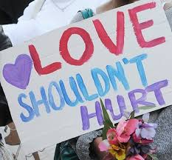
Thank you!
Stay connected!
@SoarProjectCanada
@CanadaSoar
soarprojectcanada
Get in touch!
Karen.mason@soarproject.ca
Paul.vandonkelaar@ubc.ca

